Slide 1

Human Vision and Its Role in Digital Image Processing
A comprehensive exploration of how the human visual system informs and shapes modern digital image processing techniques
Digital Image Processing CoursePresented by [Name 1], [Name 2], [Name 3][Institution, Date]

Slide 2

Why Human Vision Matters in Digital Image Processing
Understanding how humans perceive and interpret visual information is fundamental to developing image processing algorithms that are both effective and perceptually meaningful. Our visual system serves as the gold standard for how images should be processed, enhanced, and displayed.
Perception Foundation
Algorithm Design
Human vision is our reference point for evaluating image quality and fidelity in all digital systems.
Image processing techniques are optimized to match human visual capabilities and preferences.
Quality Assessment
Perceptual metrics measure how closely processed images align with human vision standards.

Slide 3
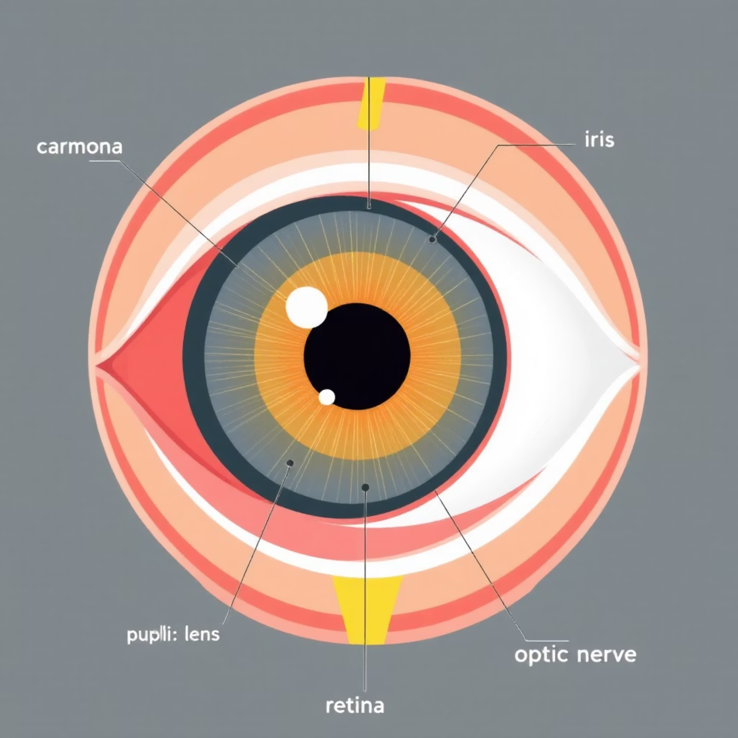
The Architecture of the Human Eye
The eye functions as a sophisticated optical instrument, precisely designed to capture and focus light onto the photosensitive retina. Each component plays a critical role in transforming light energy into visual information our brain can interpret.
Key Components
Cornea: Clear outer layer that begins focusing light
Pupil: Adjustable aperture controlling light entry
Lens: Dynamic focusing element for sharp imagery
Retina: Light-sensitive tissue containing photoreceptors
Optic Nerve: Transmits visual signals to the brain

Slide 4


Image Formation: From Light to Signal
Light Entry
Light passes through the cornea and pupil, with the pupil controlling intensity based on lighting conditions.
Lens Focusing
The lens adjusts its shape to focus light precisely on the retina, creating a sharp optical image.
Photoreceptor Conversion
Specialized cells in the retina absorb photons and convert light energy into electrical impulses.
Neural Transmission
Electrical signals travel through the optic nerve to the visual cortex for interpretation.

Slide 5



Photoreceptors: Rods and Cones
The retina contains two types of photoreceptors, each specialized for different lighting conditions and color sensitivity. Their distribution and characteristics directly influence our visual capabilities and inform image sensor design.
Rods
Cones
Spatial Distribution
Extremely sensitive to light, enabling vision in low-light conditions. Provide grayscale vision with no color information. Approximately 120 million rods per eye.
Less light-sensitive but enable color vision. Three types respond to red, green, and blue wavelengths. About 6-7 million cones per eye, concentrated in the fovea.
Cones concentrate at the fovea for detailed color vision, while rods dominate peripheral areas for motion detection and low-light sensitivity.

Slide 6

Brightness and Contrast Perception
The human eye doesn't perceive brightness linearly. Instead, it adapts to ambient lighting conditions and responds to relative differences rather than absolute values, a principle that fundamentally shapes contrast enhancement algorithms.
Light Adaptation
Dark Adaptation
DIP Application
When moving from darkness to bright light, the pupil constricts and photoreceptors desensitize, allowing comfortable vision across an enormous range of intensities.
In dim conditions, the pupil dilates and rods regenerate light-sensitive pigments, gradually improving night vision over 20-30 minutes.
Histogram equalization and contrast enhancement algorithms mimic adaptation to improve visibility and detail in underexposed or overexposed images.

Slide 7





Color Vision and Image Processing
Human color perception follows the trichromatic theory, where three cone types detect different wavelengths. This biological reality directly influenced the RGB color model and modern color image processing techniques.
Red Cones
Green Cones
Peak sensitivity around 560 nm, enabling perception of long-wavelength red light.
Peak sensitivity around 530 nm, responding to medium-wavelength green light.
Color Spaces
Blue Cones
RGB, HSV, and CMY models translate human color perception into mathematical frameworks for digital processing.
Peak sensitivity around 420 nm, detecting short-wavelength blue light.

Slide 8

Visual Illusions and Perception Limits
The human visual system can be deceived through optical illusions, revealing that perception involves active interpretation rather than passive image capture. Understanding these limitations is crucial for designing robust image processing algorithms.
Why Illusions Matter
Algorithm Implications
They demonstrate that perception is constructed by the brain, not simply recorded. What we see depends on context, expectation, and prior experience.
Image processing must account for perceptual limits and biases. Algorithms optimized for mathematical precision may produce visually unpleasant results.
Design Principle
Effective image processing algorithms consider human perception characteristics, ensuring that enhanced images match viewer expectations and visual preferences.

Slide 9
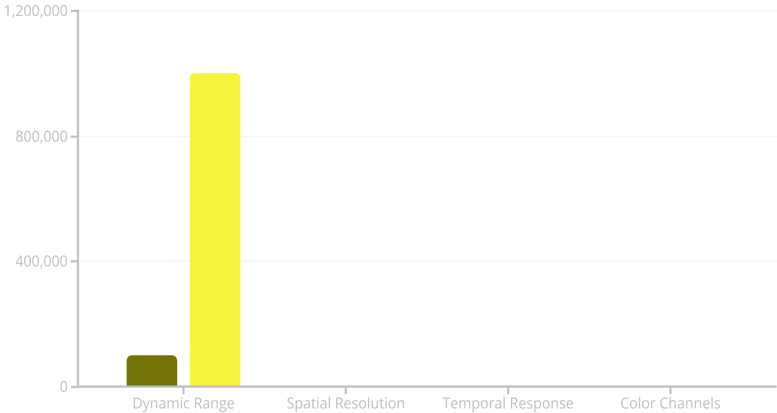
The Limitations of Human Vision
While remarkably sophisticated, the human visual system has measurable constraints. Understanding these limits helps us appreciate what digital imaging sensors can achieve and where image processing must compensate for human perceptual boundaries.
Human Eye
Digital Sensor
Dynamic range: Ratio values (human vs. sensor pixels per second). Spatial resolution: Relative units. Temporal response: Frames per second. Digital sensors often exceed human capabilities, but require processing to match perceptual quality.

Slide 10

Human Visual System Modeling in DIP
HVS models mathematically represent human visual perception, enabling algorithms to process images in ways that align with how humans actually perceive them. These models are essential for perceptually-optimized compression and quality assessment.
Visual Sensitivity
Masking Effects
Spatial frequency response functions that model which image details humans perceive most clearly.
Algorithms that exploit perceptual masking—where visible details mask the visibility of artifacts.
Attention Models
Perceptual Coding
Computational models predicting where humans look, enabling smart prioritization of quality in important regions.
JPEG and modern codecs use HVS models to achieve high compression while maintaining visual quality.

